Slide 1


Slide 2


CONTENT
01
PROBLEM STATEMENT
02
DESCRIPTION
03
SOLUTION/APPROACH
04
TECHNOLOGY STACK
05
ARCHITECTURAL DIAGRAM

Slide 3
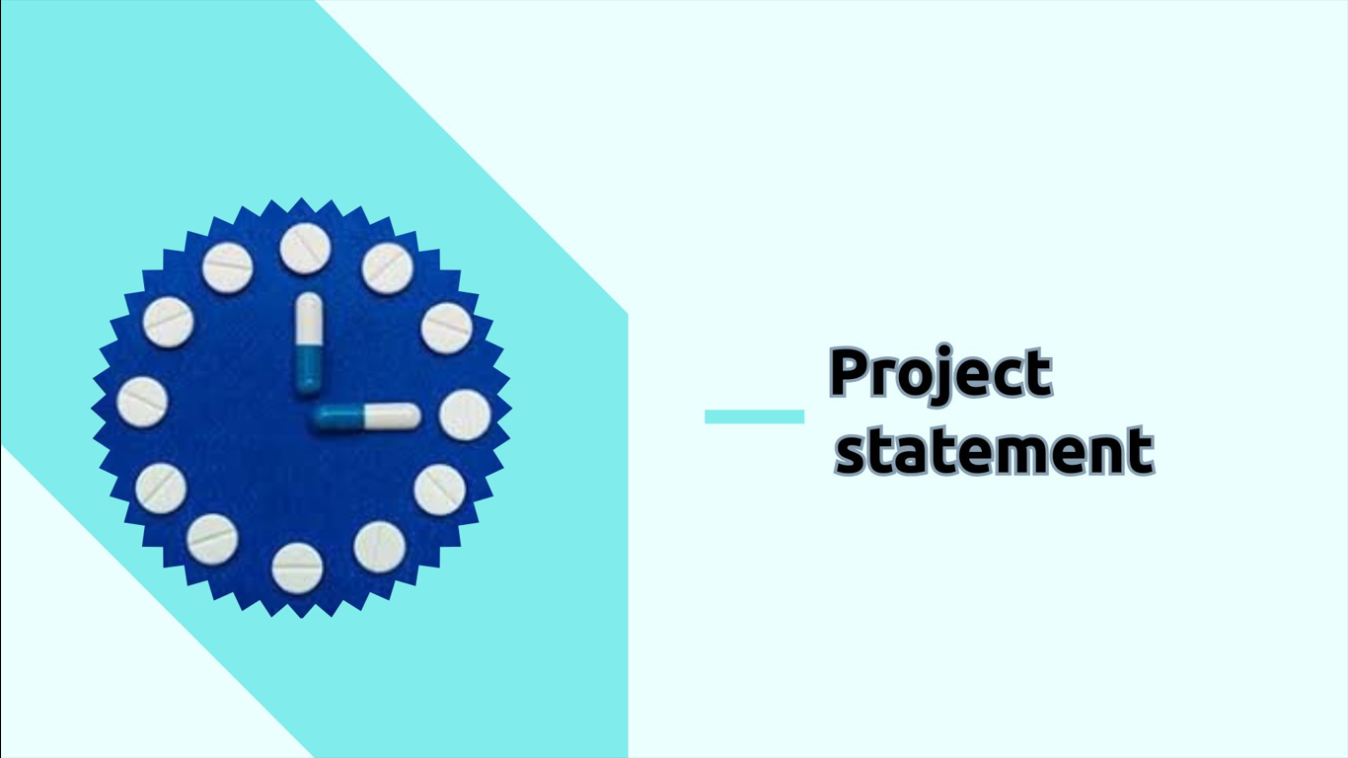

Slide 4
In the realm of healthcare and pharmaceuticals, numerous challenges persist that affect both consumers and the medical professionals responsible for dispensing medications. These challenges are multifaceted and can have wide-ranging consequences on the safety, well-being, and overall healthcare experience of individuals.

Slide 5
Problem 1: Fragmented Medicine Information
- Medications are commonly packaged in sheets containing multiple tablets or capsules. However, the critical information associated with these medicines, including expiration dates, manufacturing dates, batch numbers, and chemical compositions, is often spread across the sheet. This results in a fragmentation of vital data. When consumers purchase a portion of the sheet, they might inadvertently miss crucial details. This information fragmentation poses a significant health risk as it hampers the ability of consumers to make informed decisions about their medications.

Slide 6
Problem 2: Medication Mix-Up
- Within the bustling environment of medical shops, it is not uncommon for shopkeepers to become overwhelmed, leading to errors in dispensing medications. These errors can result in consumers receiving the wrong medication, a scenario that can have severe health consequences. The issue is exacerbated when consumers cannot identify the medication they should receive, particularly if they are illiterate or unfamiliar with the medicines they require.

Slide 7
Problem 3: Lack of Medication Understanding
- The complexity of the pharmaceutical landscape can be daunting even for medical shop owners. In some cases, medical professionals themselves may struggle to differentiate between various medications and their intended uses. This confusion can lead to incorrect sales and an inability to provide accurate guidance to consumers regarding the medications they require for their specific health conditions.
These problems underscore the pressing need for a comprehensive solution that addresses the fragmentation of medical information, mitigates the occurrence of medication mix-ups, and enhances the understanding of medications among both consumers and medical shop owners. The aim is to create a safer, more informed, and accessible healthcare environment, ensuring the well-being of individuals and promoting responsible medication use.

Slide 8

DESCRIPTION

Slide 9
Description:
To address these challenges, we propose the creation of "Medicite," a comprehensive web platform dedicated to providing all essential information about medicines, including their expiry date, manufacturing date, batch number, chemical composition, and more. It can also provide details about its dosage and precautions. Medicite aims to empower both consumers and medical shop owners by offering a one-stop solution for medication-related concerns.

Slide 10

SOLUTIONS/APPROACH

Slide 11
Solution/Approach:
Medicite offers a wide range of features to tackle the identified problems:
Medicine Information Database: It stores detailed information about medicines, easily accessible by entering the medicine's name or its batch number.
Medicine Alternatives: Recommends alternative medicines for common ailments based on user input, reducing the risk of medication mix-ups.
Dosage Calculator: Helps users determine the correct dosage based on age, weight, and the specific medicine, ensuring safe medication use.
Medicine Expiry Alerts: Allows users to set up alerts for medicine expiration dates, preventing the use of expired drugs.
Medication Disposal Guidelines: Offers guidance on the safe disposal of expired or unused medications, promoting environmental and safety awareness

Slide 12

TECHNOLOGICAL
STACK

Slide 13
By using the modern web technologies languages likes Html5, CSS
Javascript ,Php, and react js we designed the website in a easy and
efficient manner so that the client who is receiving the data
Will be easy to access to our website and clear their doubts without any fear
If they had any interest they can donate some money to our fund
Which we use th provide medical services at places where it is less and scarce

Slide 14




Architectural diagram

Slide 15
User enters Medicine name or batch number
System searches the database
If Medicine is found:
- Display related information about the medicine and the dosage
If Medicine is not found:
- Display the "Medicine not found" message
User opens the Medicine Website

Slide 16



"Empowering Access, Ensuring Safety.
Medicite: Your Trusted Medication Companion”.
Thank you

